Slide 1
HIV Drugs
Spreadsheet Documentation

Slide 2
General Information
Link to spreadsheet: https://docs.google.com/a/binghamton.edu/spreadsheet/ccc?key=0Ag8gS12PpxX2dF82NS1CLVhwd1RDSjhiMnFpdGtUZVE&usp=drive_web#gid=1
Spreadsheet contains data regarding
Summary of company rankings
WHO groupings and country categorizations
The burden of Malaria and the data of its drugs by countries
The burden of TB and the data of its drugs by countries
The burden of HIV and the data of its drugs by countries

Slide 3
Tab (1) Summary of Company Rankings
List of pharmaceutical companies, their drugs and target diseases
Ranking of the companies’ total impact scores:
Total impact scores = Need (DALYs lost) * Access (Treatment coverage) * Efficacy
Ranking of the companies break down by diseases
Total DALYs alleviated in different diseases break down by WHO regions

Slide 4
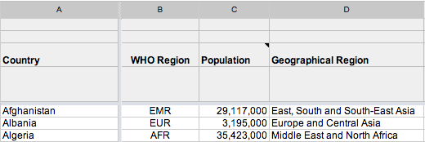
Tab (5) HIV by Country
General information
Column A: List of countries
Column B: Countries sorted by WHO regions
Column C: population
Column D: Geographical Region

Slide 5
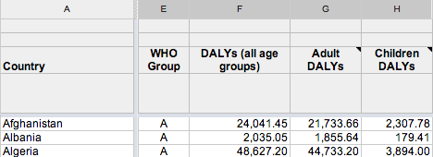
Tab (5) HIV by Country
General information (continued)
Column E: WHO Group (“A” or “B”)
Column F: DALYs lost to HIV by country (2010)
Column G: DALYs lost by adults to HIV by country (2010, adults = 15+)
Column H: DALYs lost by children to HIV by country (2010, children = <15)

Slide 6
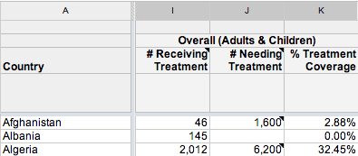
Tab (5) HIV by Country
Treatment Coverage
Column I: Overall individuals receiving treatment by country (2010)
Column J: Overall individuals needing treatment by country (2010)
Column K: Treatment coverage for all individuals by country (Col I / Col J)

Slide 7
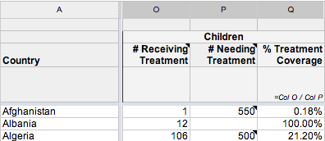
Tab (5) HIV by Country
Treatment Coverage (continued)
Column O: # of children receiving treatment by country (2010)
Column P: # of children needing treatment by country (2010)
Column Q: Treatment coverage children by country (Col O / Col P)

Slide 8
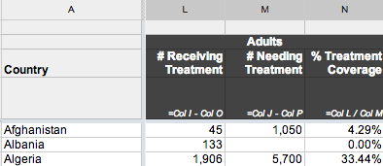
Tab (5) HIV by Country
Treatment Coverage (continued)
Column L: # of adults receiving treatment by country (Col I – Col O)
Column M: # of adults needing treatment by country (Col J – Col P)
Column N: Treatment coverage children by country (Col L / Col M)

Slide 9
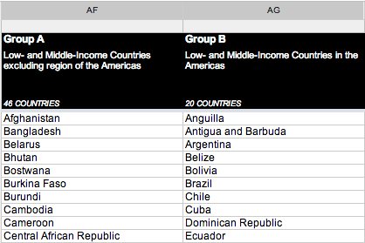
Tab (5) HIV by Country
WHO Group
Column AF: WHO-designated group A countries
Column AG: WHO-designated group B countries

Slide 10
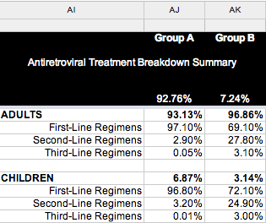
Tab (5) HIV by Country
Treatment Breakdown Summary
Column AJ: Breakdown of treatment in WHO-designated group A countries
Column AK: Breakdown of treatment in WHO-designated group B countries
Example: of those receiving treatment, 92.76% are in group A countries. Of those, 93.13% are adults. Of those adults, 97.10% receive first-line treatment regimens

Slide 11
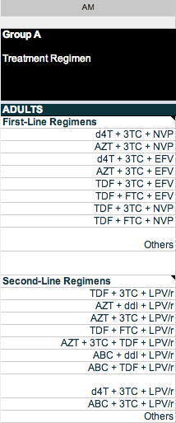
Tab (5) HIV by Country
Treatment Efficacy
Column AM: List of treatment regimens in WHO-designated group A countries:
Treatment is first broken down into four quadrants: adult first-line, adult second-line, children first-line, and children second-line. The treatments for each quadrant are then listed

Slide 12
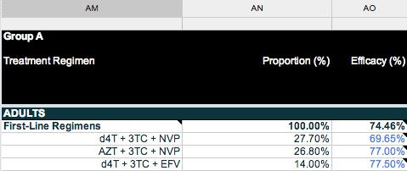
Tab (5) HIV by Country
Treatment Efficacy (continued)
Column AN: Proportional breakdown of percent in quadrant receiving treatment with the regimens listed in AM
Column AO: Efficacy of each treatment regimen in that quadrant

Slide 13
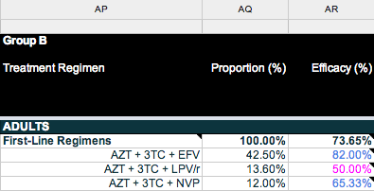
Tab (5) HIV by Country
Treatment Efficacy (continued)
Columns AP-AR: The same procedure of regimen breakdown is repeated for WHO-designated group B countries

Slide 14
Tab (5) HIV by Country
Impact
Regimen impact is calculated by:
Age-specific DALYs (Col G or H) *
Age-specific treatment coverage (Col N or Q) *
Percentage of cases receiving each particular type of treatment (Col AJ or AK) *
Proportion of cases of receiving that type of treatment receiving each particular regimen (Column AN or AQ) *
Efficacy of each regimen in that quadrant (Col AO or AR)

Slide 15
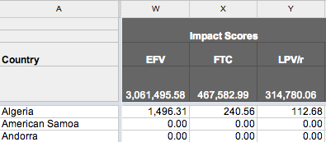
Tab (5) HIV by Country
Impact (continued)
Columns R-AC: Impact of each drug by country
For every regimen of which each drug is a part, the drug receives (1/n) credit of the whole regimen, where n=number of drugs
The total impact for each drug is the sum of its impact in each regimen
Column AD: Total
impact of HIV
treatment by country

Slide 16
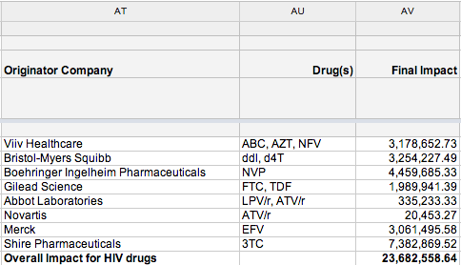
Tab (5) HIV by Country
Company Ranking
Column AT: List of originator companies for HIV treatment
Column AU: Drugs credited to each company
Column AV:
Total impact
of each
company for
HIV treatment

